Slide 1

Forest Economic Partnership
Stakeholder Meeting
13 September 2023

Slide 2
Welcome

Slide 3
Agenda
Arrival, refreshments & networking 17:00 - 17:15
Welcome, introduction, and news – (Ian Mean)
New stakeholders - Welcome Nick Shrager and Deborah Flint, Q+A (Ian Mean)
BAM – Five Acres Sub-Contract Opportunities (Matthew Williams and Jason Lamb)
New Rural Business Grants - Rural England Prosperity Fund introduction plus Q&A with grant administrators ALP Synergy, (Anthony Parsons and Louise John)
FEP Board Governance & finances – (Wendy Jackson)
Education and Skills sub group update - (Clare Vertigen)
Digital Connectivity sub group update - (Angela Presdee and Wendy Jackson)
Meeting close at 18:30

Slide 4
Welcome to all and FEP news. Introduction to Nick Shrager and Deborah Flint, Q+A – Ian Mean

Slide 5
BAM – Five Acres Sub-Contract Opportunities (Matthew Williams and Jason Lamb)

Slide 6


Five Acres Redevelopment – FEP Presentation

Slide 7

Introduction
Who are BAM?
Where are BAM based?
What services to BAM provide?
BAM key Values

Slide 8

Five Acres Redevelopment

Slide 9
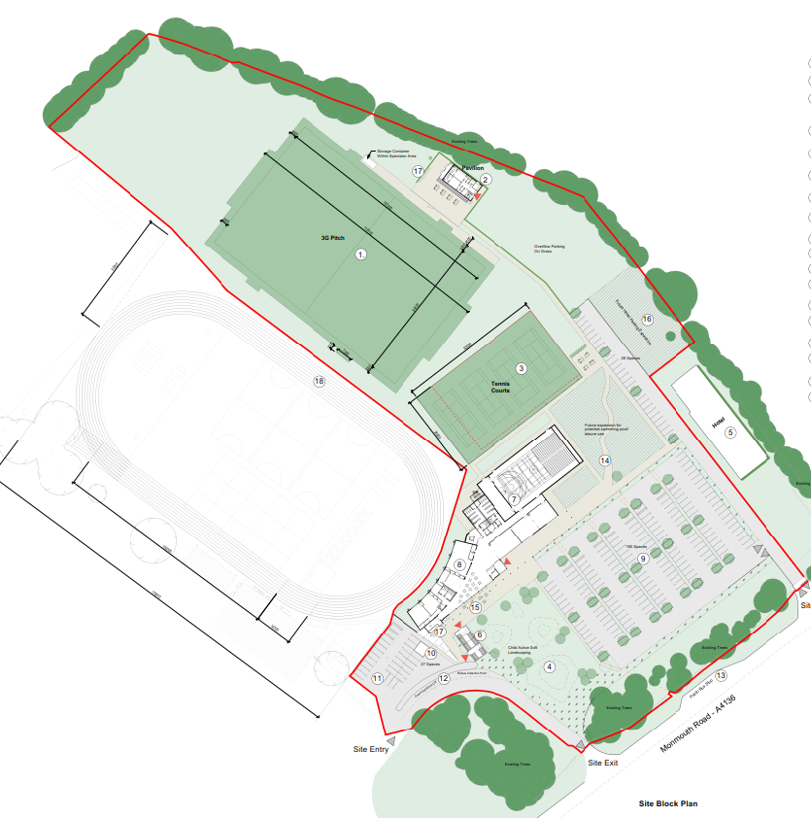
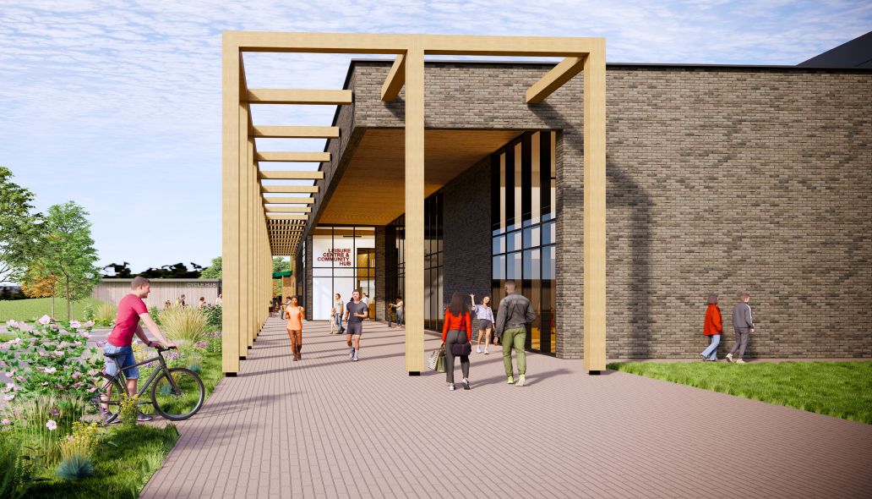
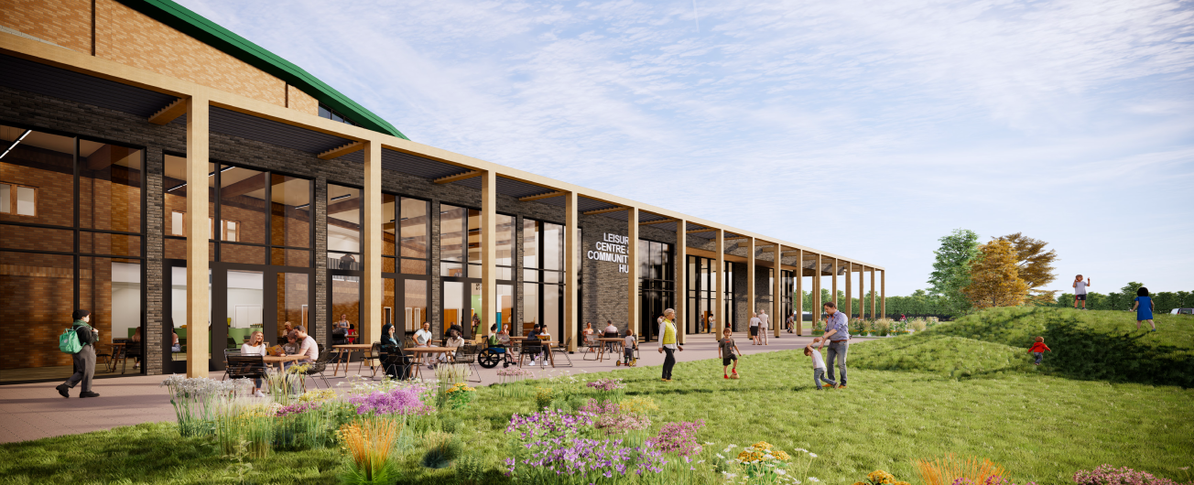
Five Acres Redevelopment Proposals

Slide 10
Meet The Buyer Event

Slide 11
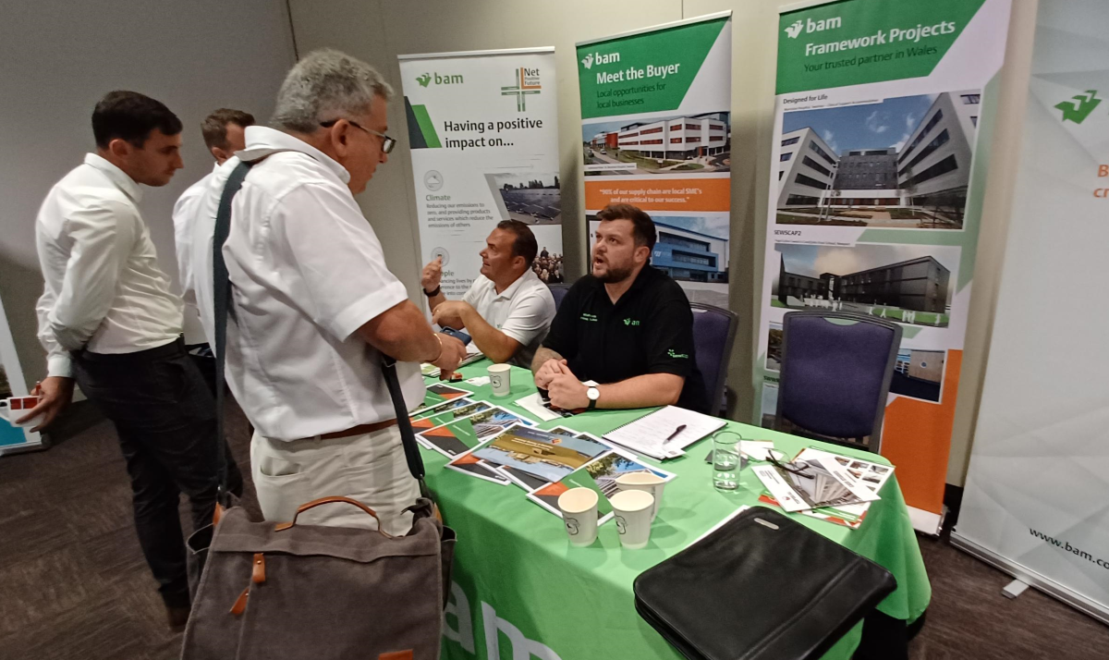
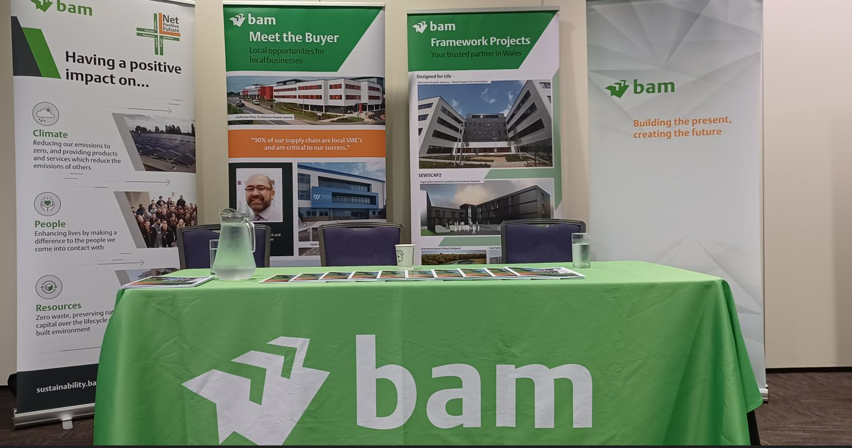
What is Meet the Buyer?
Where will this event take place?
When will this take place?
Which local companies should attend?
Any other local stakeholder engagement?

Slide 12
Any Questions?

Slide 13

Rural England Prosperity Fund (REPF)
Rural Business Grants, Louise John and Ant Parsons

Slide 14
Rural England Prosperity Fund (REPF)
Rural Business Grants, Louise John and Ant Parsons
1. Funding Offer | 2. Funding Criteria | 3.Timeline
Funding awards between £3,000 - £25,000. Match Funding of 20% required. Year 1: (present - end of March 2024) - £50,000 (capital) Year 2: (April 2024 - March 2025) £150,000 (capital) £41,000 (revenue) | Type of projects to be funded: Digital Infrastructure installations Investment in land & property to create new commercial floorspace Bringing vacant or underused floorspace into use. Farm diversification Developing tourism and hospitality sector physical assets. Investment in renewable energy installations. Premise, plant & equipment investment to support decarbonisation. | Currently starting grant process for Year 1. Full application process end of this month. First panel meeting in November. Funding awarded before Christmas. Year 2 - We will be advertising this round in February. We are likely to go to a full application process for this round. Please contact Louise.John@fdean.gov.uk for more

Slide 15
FEP Board Governance & finances - Wendy Jackson

Slide 16
FEP Board Governance & finances - Wendy Jackson
Bernie O’Neill resigned his position as Vice-Chair due to changes in the FoDDC Cabinet following the May elections, but retains his position as CIC Board Member. As the new cabinet member of economy, Cllr Johnathan Lane will be appointed as CIC Board Member and Vice-Chair of the FEP Stakeholder Group.
Three new nominees to the CIC Board will observe the next 3 Board meetings, before a Director vote is held and a formal invite to join the Board is sent to the nominees.
All changes will be formally notified to Companies House

Slide 17
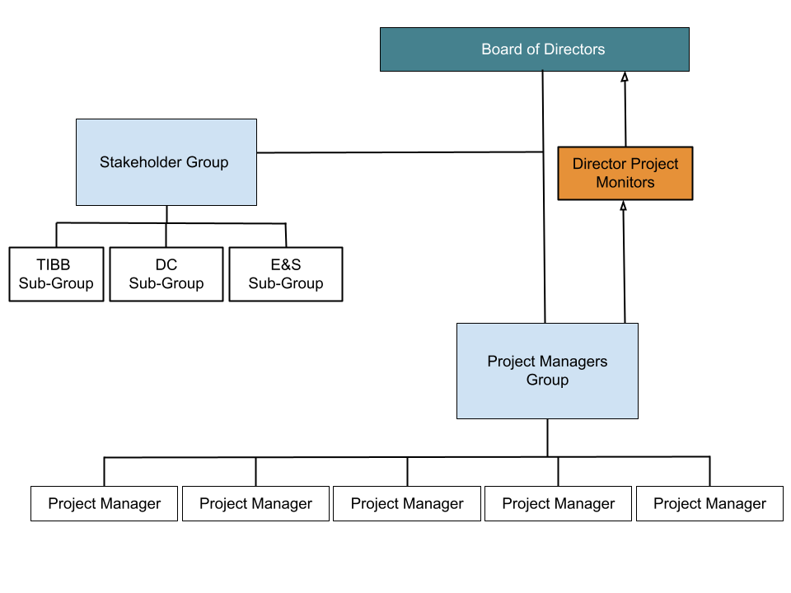
FEP Governance

Slide 18
FEP Board Governance & finances - Wendy Jackson
CIC policies prepared to support good governance:
Health & safety
Safeguarding
Whistleblowing
Expenses
FEP Privacy Notice (GDPR & website compliance)
Directors handbook

Slide 19
FEP Board Governance & finances - Wendy Jackson
 | Income | Expenditure
Balance Tracker | £58,611.25 | £38,773.74
Inspiring the Forest Funding to date | £25,750.00 | £22,447.55
Core Spending | £5,468.25 | £6,185.12

Slide 20

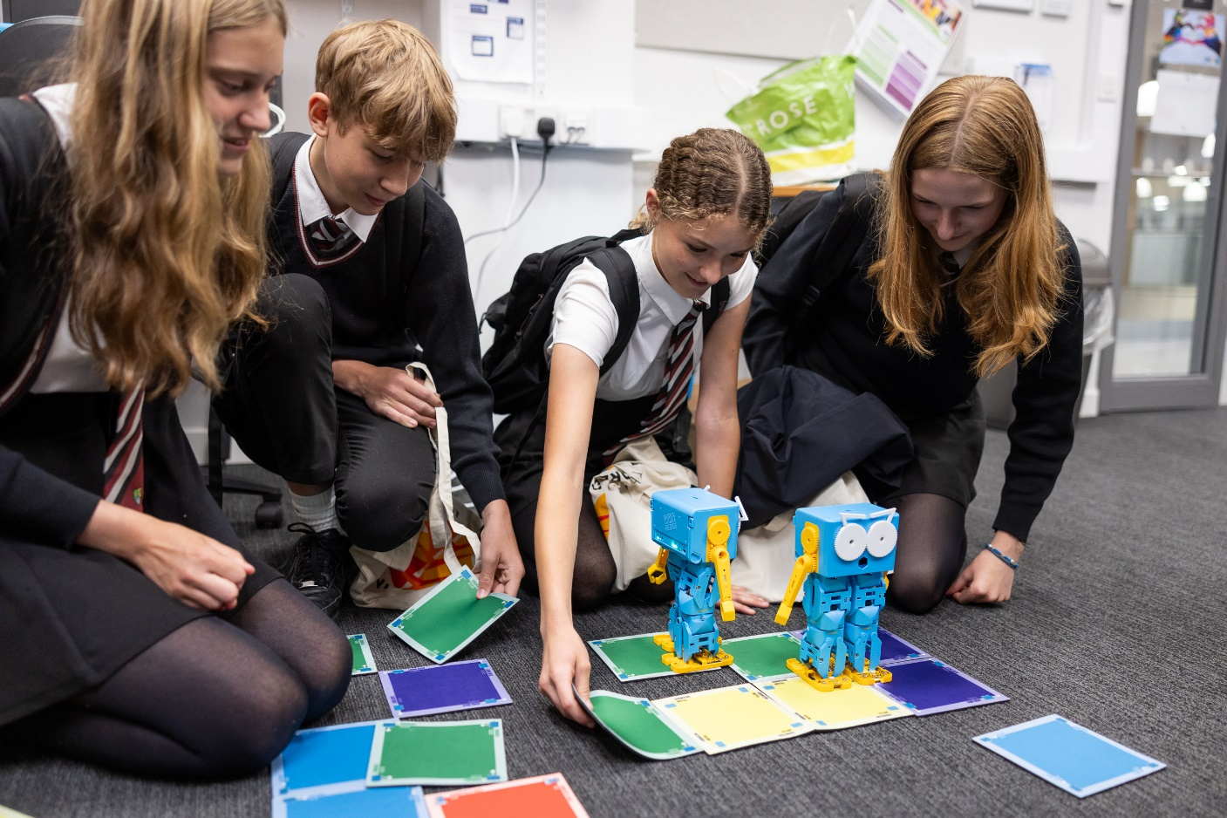
Subgroup update – Education and Skills, Clare Vertigen
Inspiring the Forest 30th June 2023

Slide 21
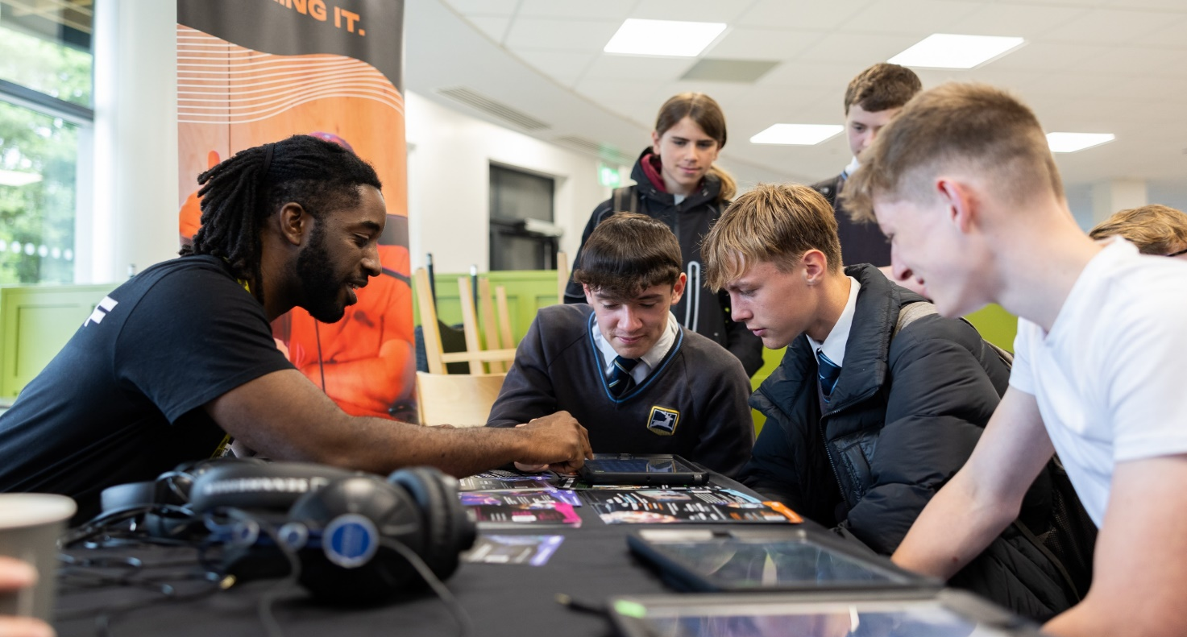
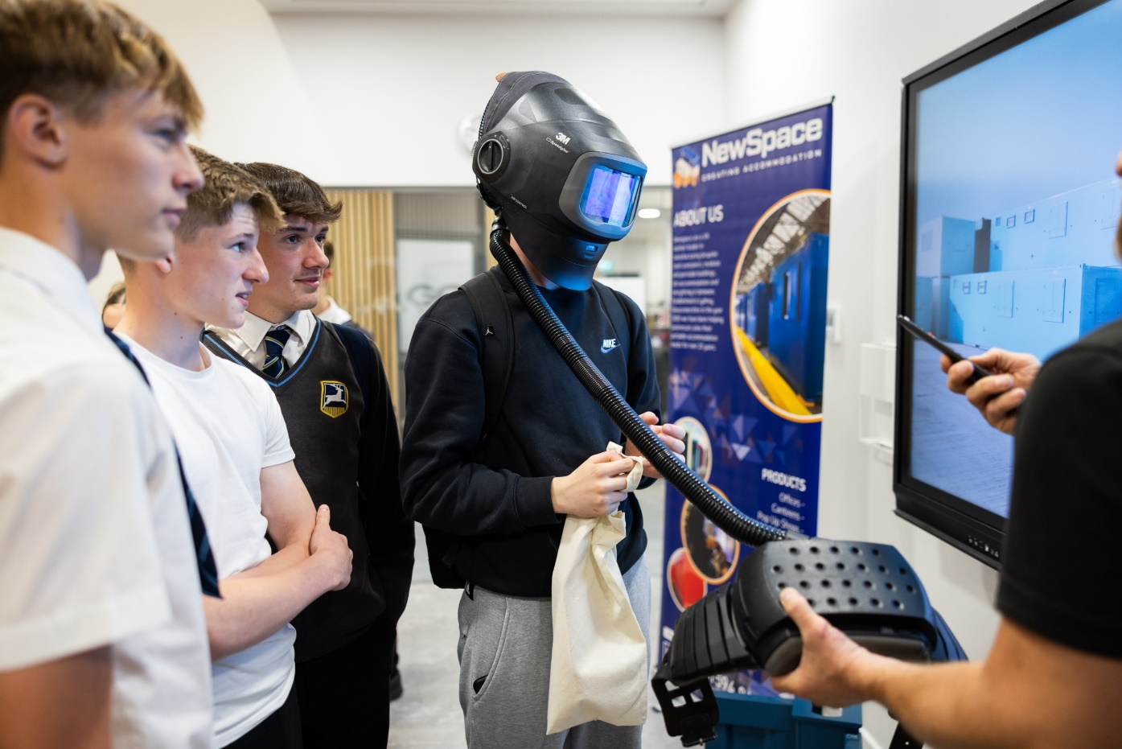
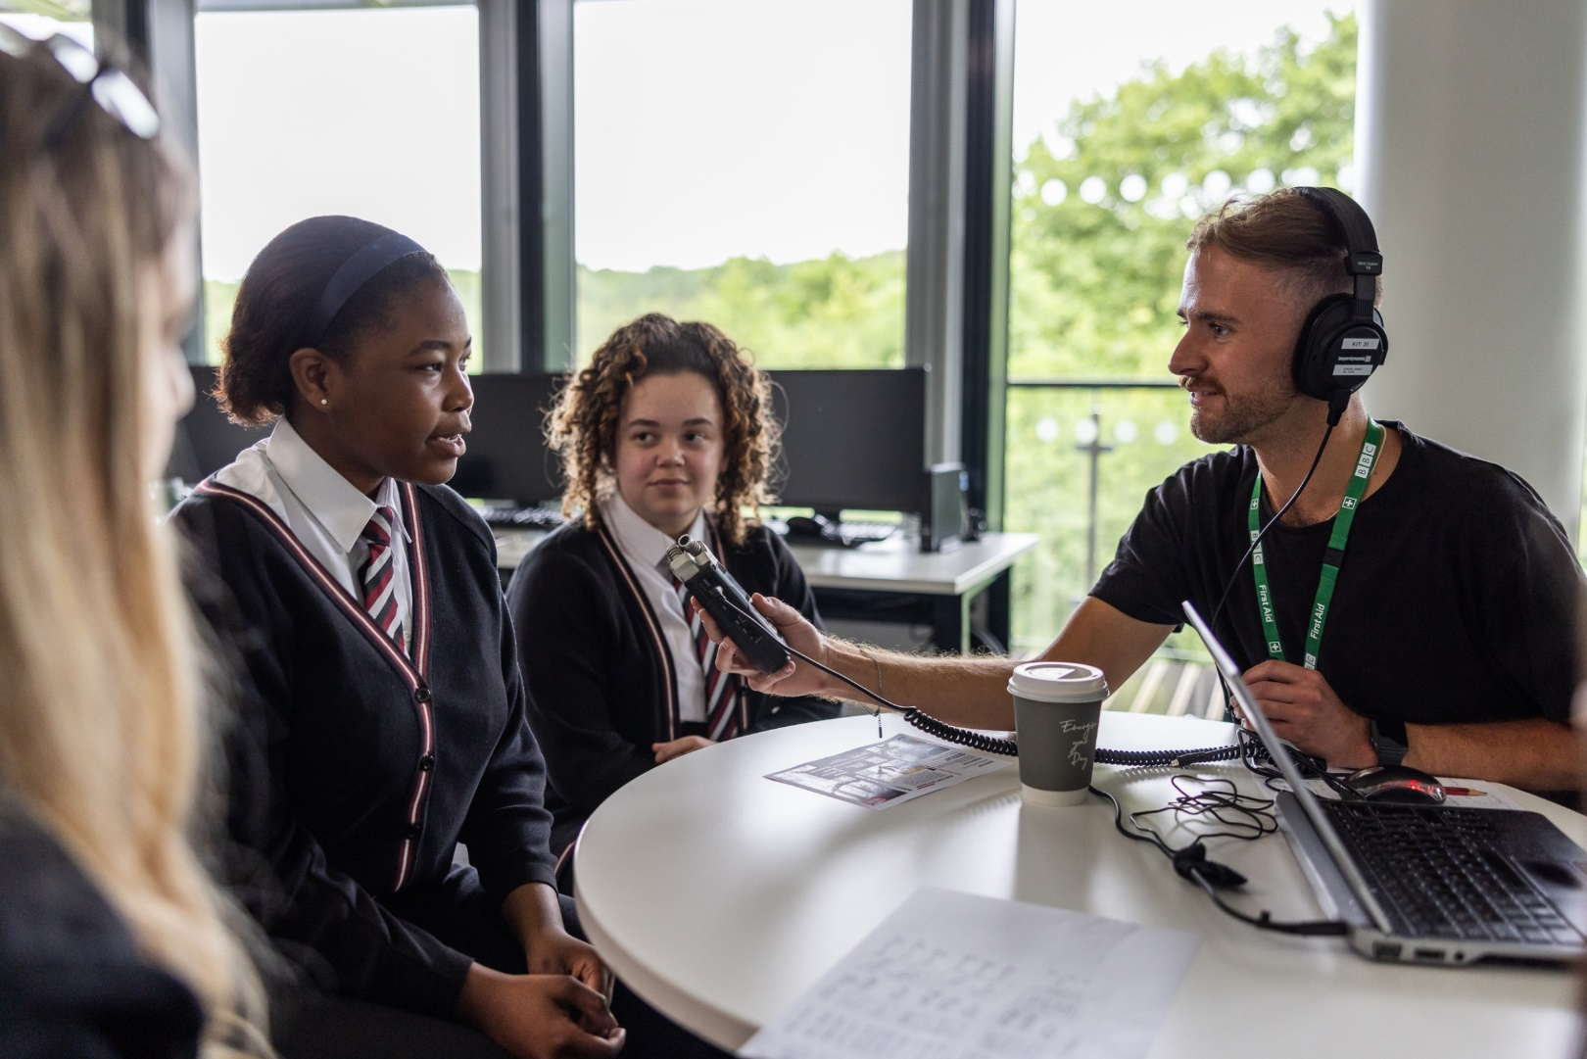

Slide 22
Subgroup update – Digital Connectivity, Angela Presdee and Wendy Jackson

Slide 23
Meeting close

