Slide 1
Forest Economic Partnership
Stakeholder Meeting
Thursday 7th December 2023

Slide 2
Agenda
1. Welcome & announcements (Neill Ricketts)
Welcome to our observers and guest speakers. Formal thank you to Tracey Ashford of Thrings for her
Co-Chairing role on E&S sub-group
2. Apologies - Stuart Emmerson, Ian Price, Rob Pickup, Clare Vertigen, Nigel Brinn, Cllr Johnathan Lane, Natalie King, Matt Stephens
3. New stakeholders Q+A (Ian Mean)
Kevan Spencer, Sales and Marketing Director at MSB Steel Ltd
Keith Thomas, author of 'The Iron Rose'.
Hakam Poselay, CEO of Checklist Films
Shaun Keep, Production Manager at Checklist Films
James Lloyd Jones, CEO of Jones Food Company
Alex Crawley, founder of Grazing Management Ltd
4. FEP Board governance & finances – new Climate Change focus (Wendy Jackson & David Trevelyan)
5. Education and Skills sub group update (Wendy Jackson)
6. Digital Connectivity sub group update (David Trevelyan)
7. FEP in 2024 - ‘Celebrating our Success’ new communications project (Ian Mean and Wendy Jackson)
8. Biosphere update (Wendy Jackson)
9. Meeting close at 18:30

Slide 3
Hello and Goodbye (Neill Ricketts)
Welcome to our guests, observers, and stakeholders.
Thank you to Tracey Ashford who is stepping back as co-chair of the Education & Skills subgroup to take on the role of District Judge at Gloucester County Court.

Slide 4
Q+A with Ian Mean
Kevan Spencer, Sales and Marketing Director at MSB Steel Ltd
Matt Stephens, Managing Director of MSB Steel Ltd
Keith Thomas, author of 'The Iron Rose’.
Hakam Poselay, CEO of Checklist Films
Shaun Keep, Production Manager at Checklist Films
James Lloyd Jones, CEO of Jones Food Company
Alex Crawley, founder of Grazing Management Ltd

Slide 5
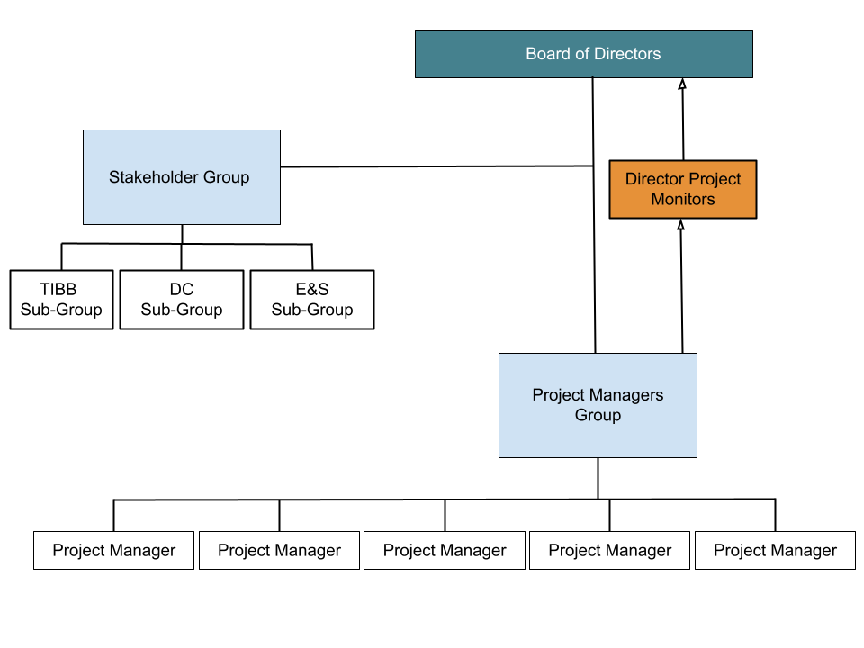
FEP Board Governance (Wendy Jackson)
New Climate Change focus
Onboarding process for new directors
Our Subgroups – Education & Skills,
Digital Connectivity, and Transport, Bridges and Borders

Slide 6
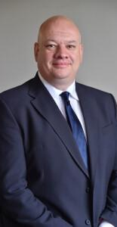
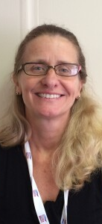
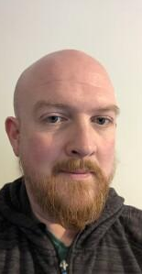
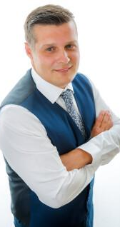
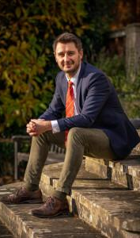
Our Directors
Stuart Emmerson
Neill Ricketts, elected Chair
Cllr Johnathan Lane, Vice-Chair
Wendy Jackson
David Trevelyan
Ian Price
Ian Mean MBE

Slide 7
Finances (David Trevelyan and Wendy Jackson)
The FEP is run by volunteers , local business leaders, who bring their expertise is specific areas and devote their time with the sole benefit of trying to improve the economy in the Forest of Dean.
The FEP keeps its ‘core funding’ requirements as low as possible so that all funds generated can be put to use on specific projects.
Projects are put forward by the stakeholders or initiated by the Board. We have a close working relationship with the Council who are supportive and assist in funding certain projects. Grant bids are also applied for by the FEP. The current project balances are as per table.
This leaves a Core Spending amount of £2k
Account balance | £22,145.97
Core costs | £1,767.20
Inspiring the Forest project | £3,302.45
Climate tool | £10,000
Growth Hub | £1,560
Biosphere | £1,323
Transport study | £3,700
FoCUS | £314.74

Slide 8
Education and Skills (Wendy Jackson)
Working with headteachers, careers leads, and employers to find out what they need the FEP to facilitate.
Schools are requesting work experience for students, and for many businesses recruitment is an issue, so we have been focusing on how we can connect schools with businesses.
Moving away from a large careers fair style event like ‘Inspiring the Forest’ and focusing on smaller events tailored to sectors and schools.
Alongside Rob Pickup, Enterprise Coordinator at GCC, developing a programme of targeted events inviting student groups to workplaces, e.g. students interested in engineering visiting a local engineering company.
Potential for ‘Dragons Den’ style events, students can plan an event or a solution to a business problem and present back to a board.
Next Education & Skills meeting is Wednesday 10th Jan 2024

Slide 9
Inspiring the Forest Competition Winner
Our Education and Skills subgroup co-chair Clare Vertigen, recently presented the winner of our ‘Inspiring the Forest’ photography competition with her Instax camera prize!
Natasha, who attends Wyedean School, sent in some excellent photos from a student perspective of the day.

Slide 10
Digital Connectivity (David Trevelyan)
•National strategy has evolved
•Upto this stage various funding routes co-ordinated locally by Fastershire
•Project Gigabit – Current contract arrangement to provide fibre deployment
Next funding strategy current local bid will know results 8/12
If successful will cover West Herefordshire and Forest of Dean where no commercial fibre roll out planned
•Fastershire still supporting builds
End phase of Fastershire projects in current round upto Apr 2024

Slide 11
Fastershire Community Grants
Success story of FEP being the community group to act on behalf of communities to deliver Fibre Broadband delivery.
•Cinderford
•Full Fibre Roll Out: Many Addresses “Ready for Service”
•Deployment ongoing
•Will need Landlord support where in Flats
•May not draw down on grant funding provided (£25K)
•Churcham
•Final stages of rollout (back haul connection planned 22nd January 2024)
•Bradley Hill
•To be completed by Dec 2023
Notes:
1.Community Grants
●
a.Cinderford - commercial rollout ongoing Full Fibre likely not to increase coverage there are already premises RFS within the town. Areas such as High Street are not complete as will require MDU solution which requires landlords approval.
b.Bradley Hill looking to complete in December
c.Churcham awaiting clearance of route for backhaul – Waiting for Gully Sucker and road space not permitted on A40 as in Christmas Embargo period and is planned to complete by 22nd Jan 2024

Slide 12
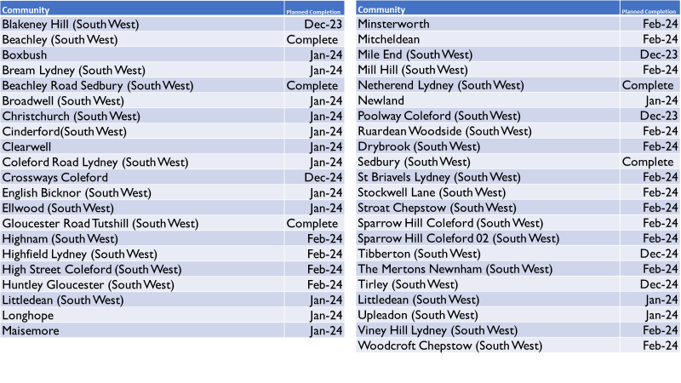

Slide 13
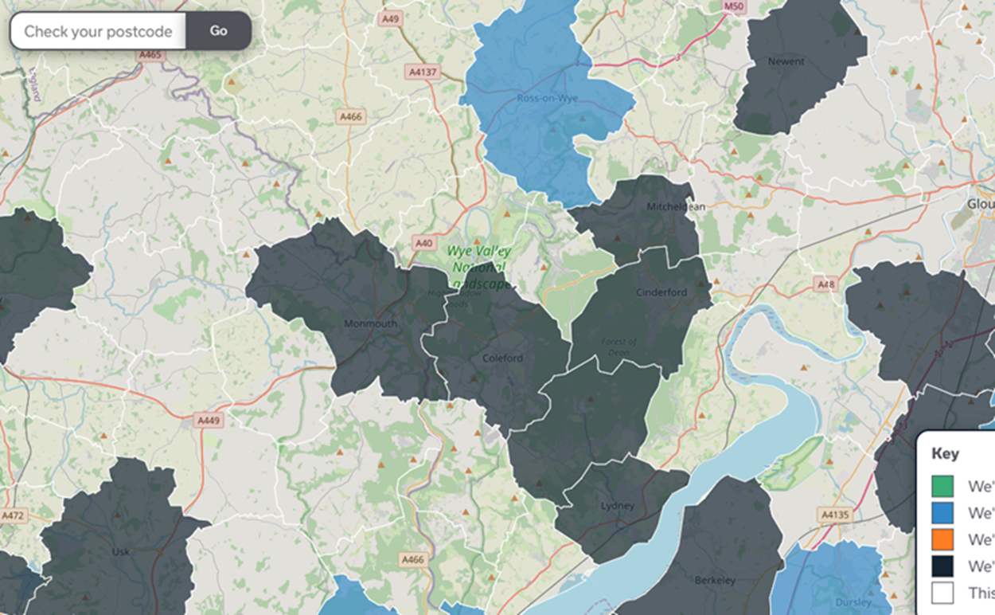
Openreach
Overbuilding Shaded Areas with Fibre (‘26-’28 est. completion)
Challenges around squirrel damage (3-6 week outages)
Outages need to be reported
Vulnerable Users
Need to register with ISPs/providers

Slide 14
Technology Changes
General Information. More important if anyone works with vulnerable users
Fibre means switching away from older (PSTN) telephone systems
Switch is from Copper Lines to newer technologies
May pose some issues during power cuts (copper provides power / fibre doesn’t)
- Much higher risk if no mobile signal locally either
- There is some guidance online
OfCom Mobile Coverage Maps are not entirely reliable when considering risk
Summary
Traditional BT Sockets and phone arrangements will change
Need to consider impacts of phones not guaranteed to work
Warning: Scammers are using this change to scam residents into unsuitable solutions

Slide 15
‘Celebrating our Success’ (Wendy Jackson & Ian Mean)
New Marketing & Communications proposal
Allocate £16,000 REPF grant funding over 2 years
Aimed at increasing awareness of FEP & participation in FEP activities
Create some new digital & hard copy marketing collateral
Develop a new FEP Business Award Scheme - suggested Innovation theme in 2024

Slide 16
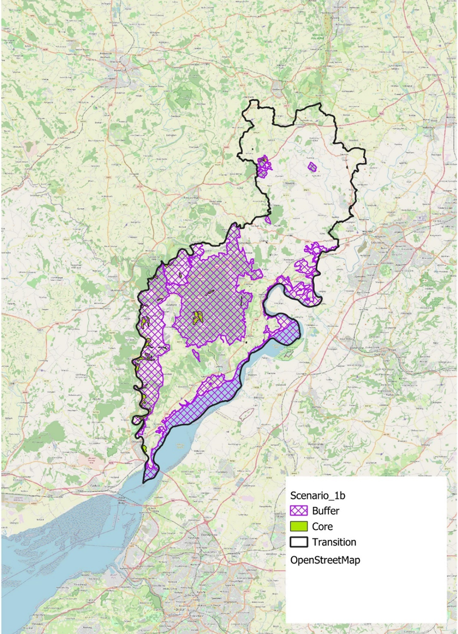
Biosphere update (Wendy Jackson)
Further information is available at:
https://www.fdean.gov.uk/planning-and-building/biosphere/
an example of a biosphere reserve with much information is: https://www.northdevonbiosphere.org.uk/
and the UK website: http://www.unesco-mab.org/
Potential Forest of Dean Biosphere Reserve
(from potential boundary paper, 2023)

Slide 17
Meeting close Thank you for attending If you’re interested in joining a sub-group or have any questions please speak to a director or email fep@fdean.gov.uk

