Slide 1

Forest Economic Partnership
Festive Networking Evening
Wednesday 4th December
17:00-18:30
AccXel Construction School

Slide 2

On the agenda...
1. Welcome & announcements (Ian Mean)
2. FEP Board governance & finances (Natalie King)
3. Education and Skills subgroup (Rob Pickup)
4. Net Zero & Climate Action subgroup and Climate Charter update (Sally Adcock)
5. Celebrating Success project (Ian Mean)
6. Announcements end.
Attendees are invited to stay for the rest of the evening and enjoy festive refreshments and networking.
Meeting close at 18:30

Slide 3
Welcome & announcements
(Ian Mean MBE, FEP Director)
General housekeeping
About the Forest Economic Partnership
Tonight’s meeting will begin with an update on recent FEP activity, then please feel free to stay for networking, mulled apple juice and mince pies. There will also be a talented singer from The Music Works joining us.
Thanks and acknowledgements

Slide 4

FEP Governance
(Natalie King, Managing Director of AccXel and FEP Director)
FEP is run by volunteers and local business leaders who offer their expertise and time for the sole benefit of improving the economy in the Forest of Dean.
The FEP Board of Directors has a total of 9 members with representatives of education, private business and the district Council. The Board is Chaired by Neill Ricketts and Cllr Johnathan Lane, Forest of Dean District Council Cabinet Member for Economy, serves as vice-Chair.
Anyone is welcome to become a stakeholder, attend meetings, nominate themselves as a director, or join a subgroup. We currently have space for 3 Directors.
The FEP has 2 active subgroups, Education & Skills and Net Zero & Climate Action, and past subgroups have focused on transport and digital connectivity in the FoD. We will be sharing updates on our subgroup activity later.

Slide 5
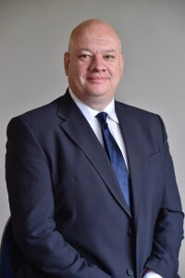
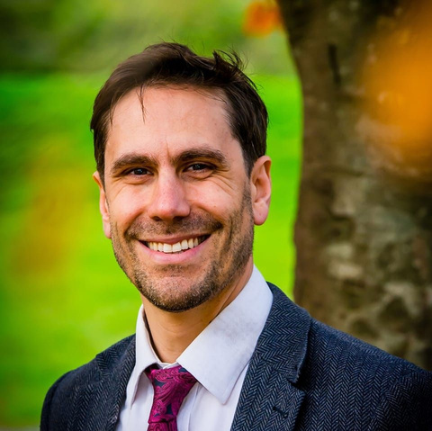
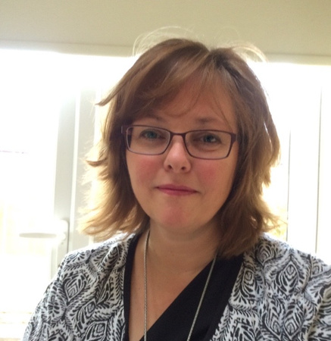
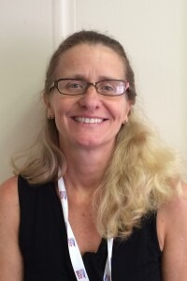
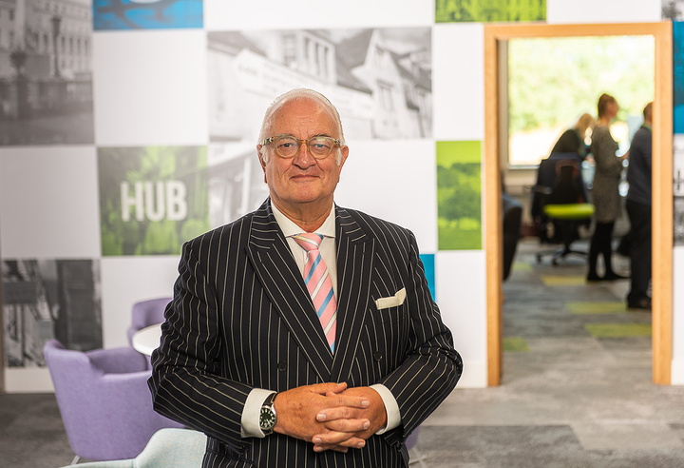
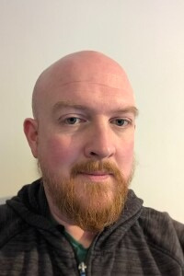
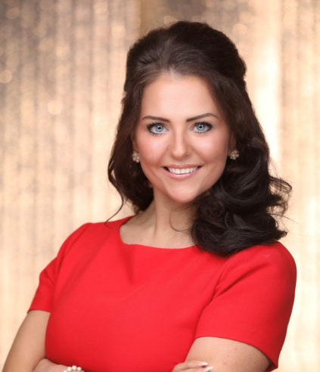
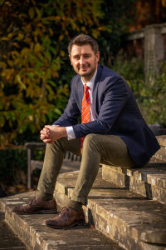
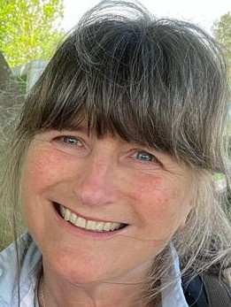
Our Board of Directors
Cllr Johnathan Lane, FoDDC Cabinet Member for Economy
Julie Tegg, Director of Apprenticeships & Employer Training at GlosCol
Wendy Jackson, Regeneration Manager
Ian Mean MBE, Director of Business West Gloucestershire
Neill Ricketts, Chair
David Trevalyan, founder of SustainYou
Natalie King, Managing Director of Accxel
Stuart Emmerson, Director of Business Development
Deborah Flint, CEO of Cinderhill Farm

Slide 6
FEP Finances
(Natalie King)
Projects are put forward by the stakeholders or initiated by the Board. We have a close working relationship with the Council who are supportive and assist in funding certain projects. Grant bids are also applied for by the FEP.The current project balances are as per table.
FEP recently recieved a further £13,000 from FoDDC’s UK Shared Prosperity Fund, leaving us with a £25,428 positive balance. This funding will support core funds and the Forest Action on Climate Collaboration Tool (FACCT).
Total account balance | £25,428
Core spending | £11,898.22
Inspiring the Forest | £3,103.35
Climate/Net Zero (combining Biosphere Reserve, Transport Study, and FoCus funds) | £8,338
Celebrating Success | £2,659.31

Slide 7
FEP Subgroups
Education & Skills
(Rob Pickup, Enterprise Coordinator at the Careers Hub)
Young Enterprise update
FEP are funding Young Enterprise sessions in local schools to offer creative and entrepreneurial learning opportunities to students.
Three schools have accepted the offer and we will be supporting them as Young Enterprise set up their chosen programmes.
Dean Academy’s Company Programme has begun already and the students are working on creating their business plans.
Dene Magna will be running Launch Pad in July 2025.
Forest High School’s sessions will be beginning shortly.

Slide 8
FEP Subgroups
Education & Skills
(Rob Pickup)
We need volunteers!
We are after local expertise to help students get the most out of the Young Enterprise programmes.
Volunteers will be supporting students through the schools chosen programme, either Launch Pad or Company Programme. These sessions vary in commitment and timings so can be flexible to your capacity.
No business experience is required and we are after a mix of backgrounds and knowledge.
Business Volunteers will support with Company Programme sessions to mentor small groups of students with the set up, running, and closure of their business. Volunteers will be required to attend 1 hour weekly meetings at school during term times.
Class Mentors support Launch Pad programmes and are required to support students with pre-designed activities over a 5-6 hour day in school.
Please speak to us or get in touch with FEP@fdean.gov.uk for more information.

Slide 9
FEP Subgroups
Education & Skills
(Rob Pickup)
International Women’s Day Project: 8th March 2025
This is an ongoing project to celebrate some of the Forest of Dean’s inspiring women for International Women’s Day 2025. The project will showcase to young people the variety of career pathways, job roles, industries that are available right here in the Forest of Dean, while highlighting some of the amazing women in our district.
We are currently filming informal ‘day in the life’ videos with a number of women who grew up, live, or work locally, and incorporating this with a career background interview.
We are ensuring a broad representation of career types and sectors, from agriculture and the arts, to small business owners and independent consultants.
These videos will be shared with schools and will be followed up by an interactive panel session at each school throughout March 2025. The panels will feature some of the participating women and students will have the chance to ask questions directly to the panellists.

Slide 10
FEP Subgroups
Net Zero & Climate Action
(Sally Adcock, Low Carbon Business Adviser at FoDDC )
This subgroup is focusing on supporting businesses as they navigate the changing climate and its impact on their operations. We aim to bridge the gap between businesses and resources, removing the technical jargon and make it as easy as possible for time poor small business to access opportunities.
The subgroup have been working on mapping out the current green activity across the FoD and beyond. This is an ongoing piece of work and will be continually updated as the landscape changes.

Slide 11
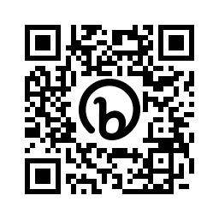
FEP Subgroups
Net Zero & Climate Action
(Sally Adcock)
Forest Climate Charter and FAACT tool
The Forest Climate Charter has been recently updated on the FEP website, along with a new members page. New business support material and promotional content is currently being finalised.
The FACCT tool will be a platform for businesses and organisations to share resources with each other targeting issues and creating solutions collaboratively. We are currently seeking quotes to create a platform to host the FACCT tool for the project to begin by Summer 2025.

Slide 12


Slide 13
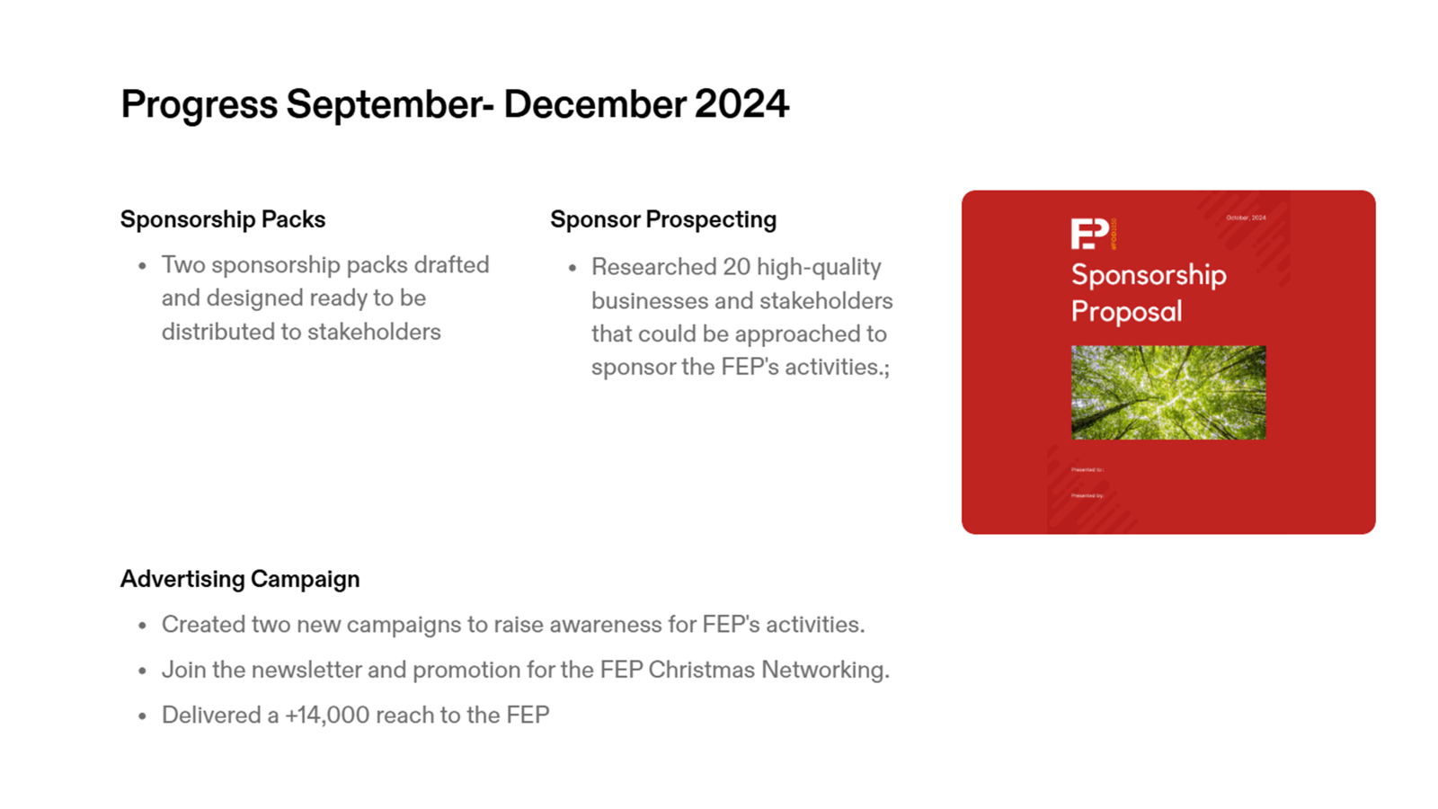

Slide 14
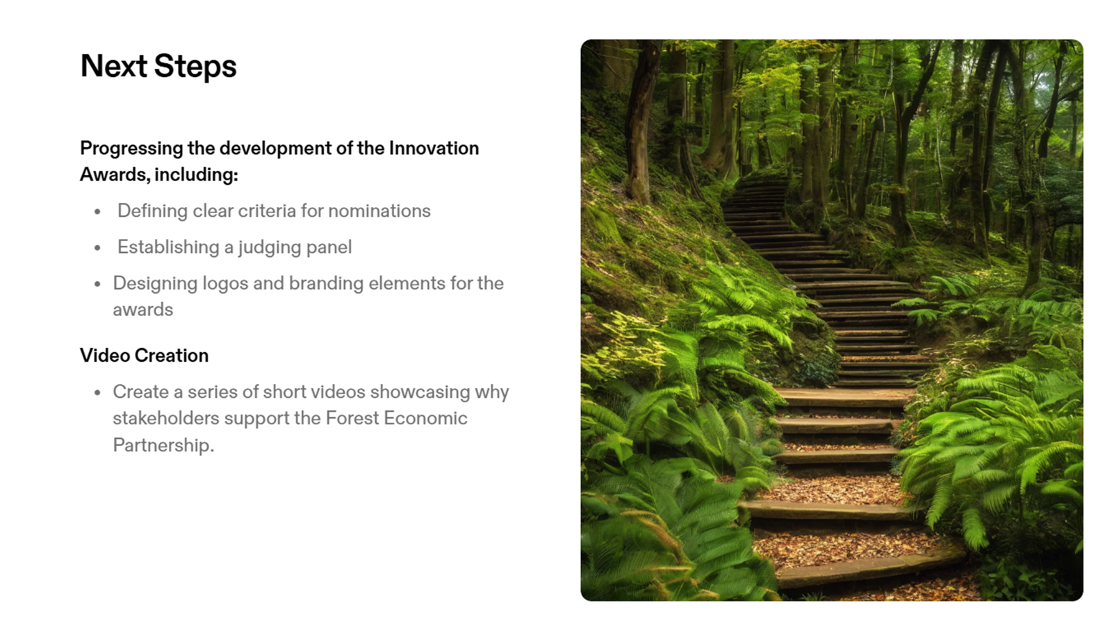

Slide 15
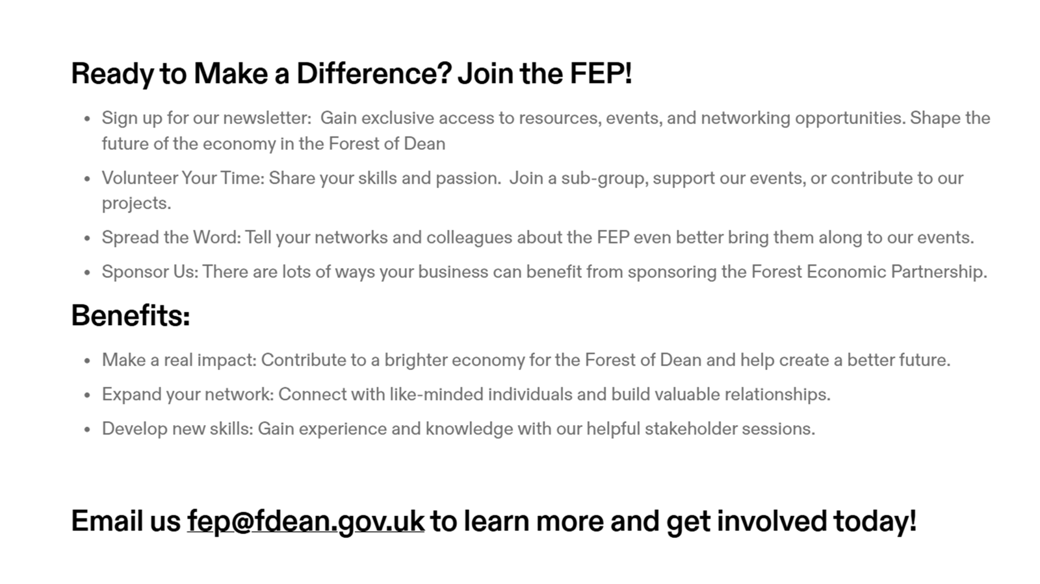

Slide 16

Please join us now for music from Vanessa, festivities, and refreshments.
If you are interested in joining a subgroup, volunteering, or have any questions please speak to a director or email fep@fdean.gov.uk

