Slide 1

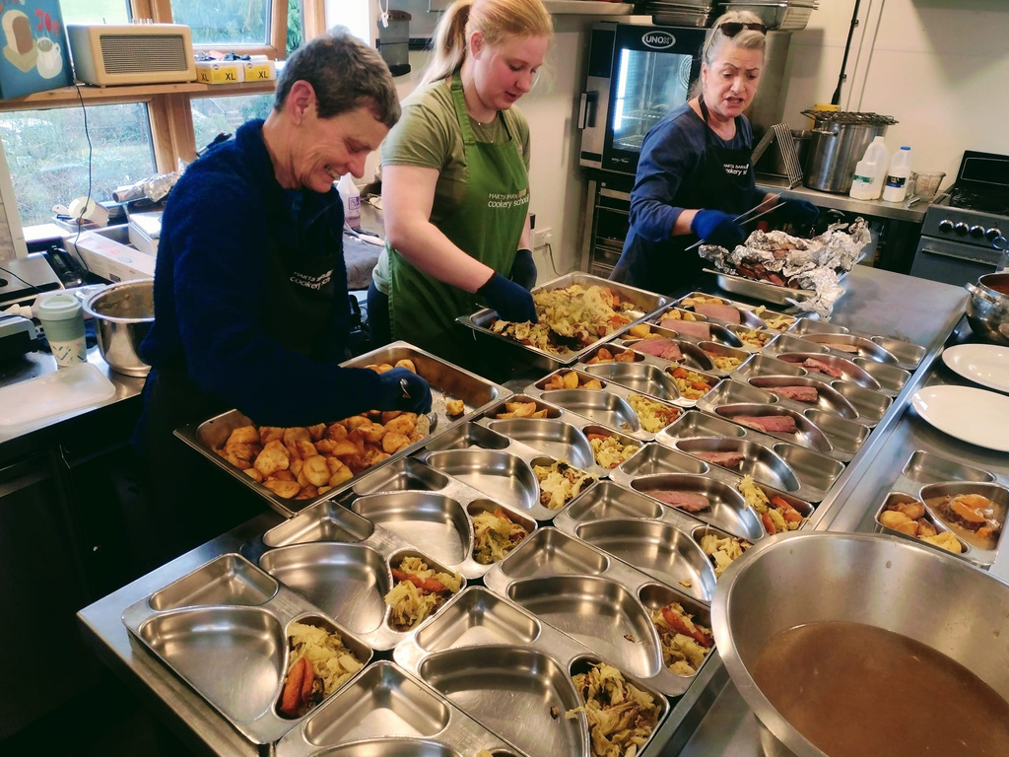

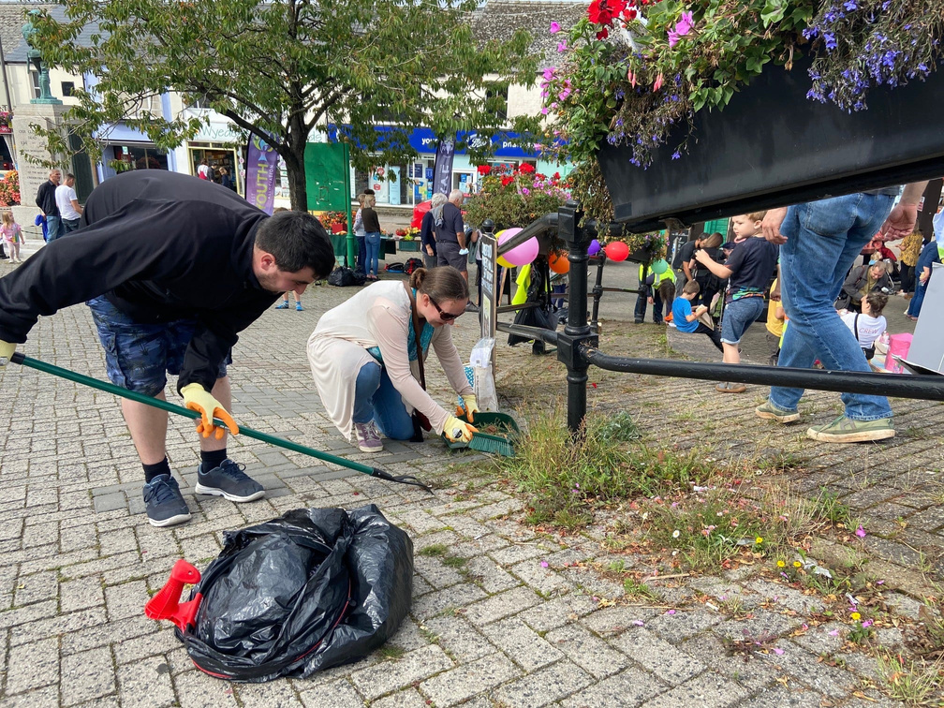
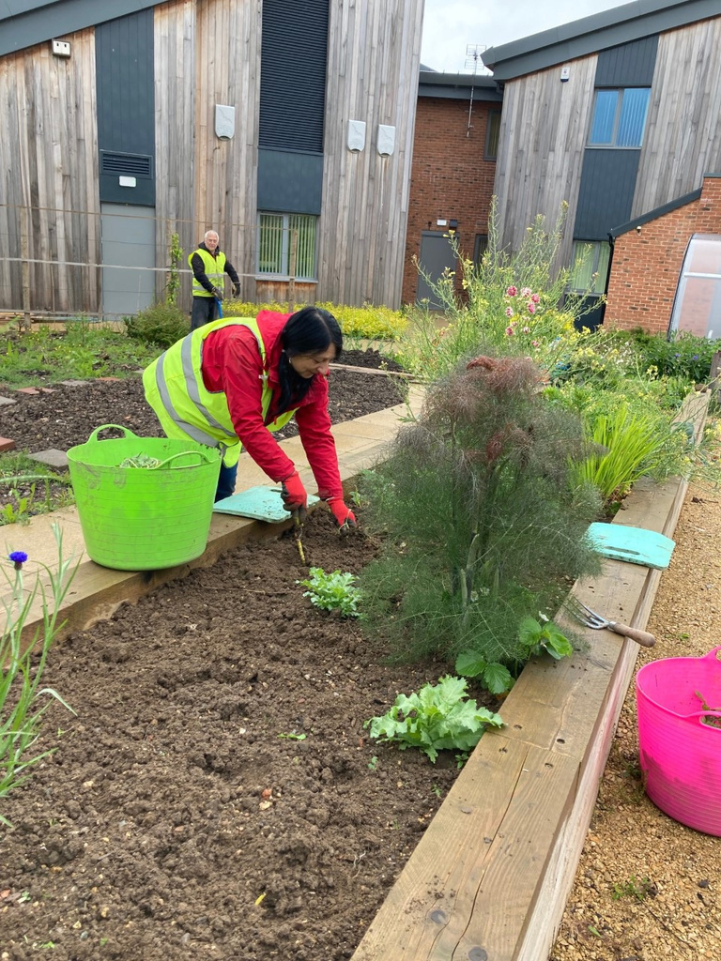
INTRO TO
FOREST VOLUNTARY ACTION FORUM
Deb Cook
Volunteering Manager

Slide 2

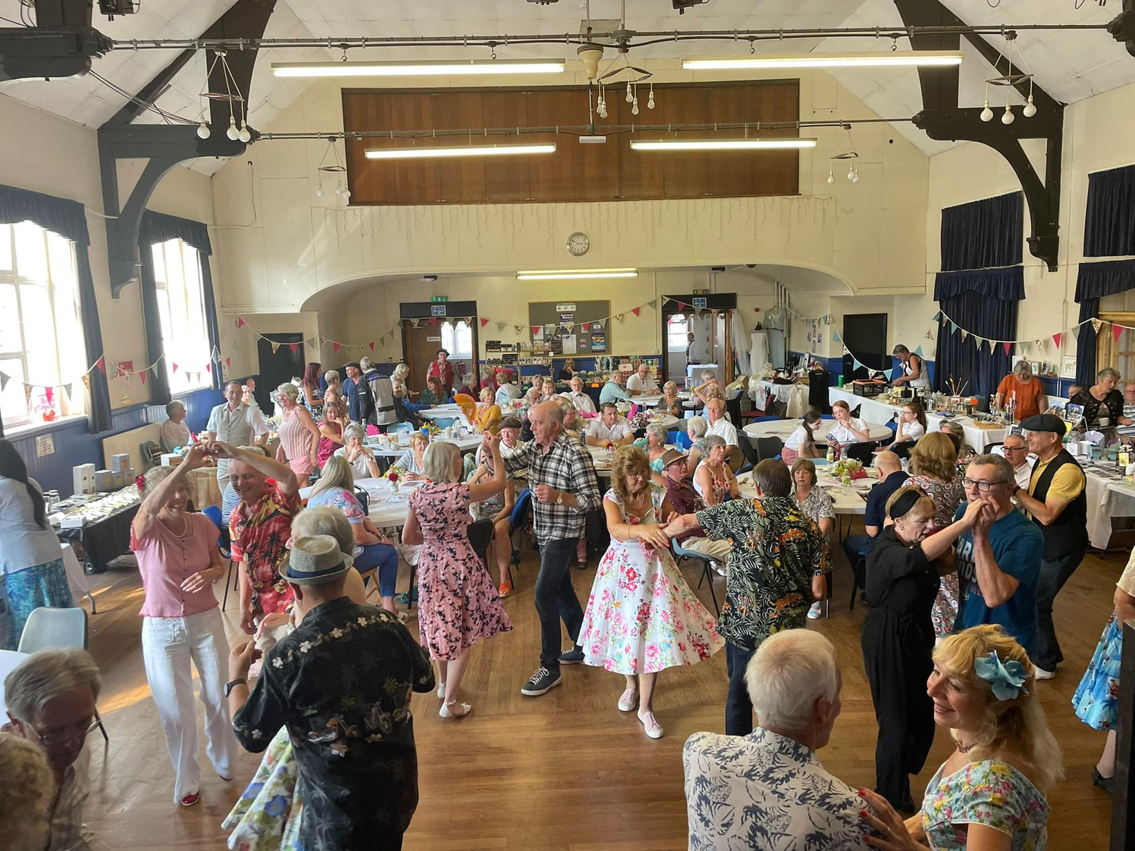


ABOUT FVAF
Voluntary Service Council
Volunteer Centre for the Forest of Dean
Supporting many of the hundreds of voluntary and community sector organisations in the Forest of Dean who are in turn better able to deliver their work in and for the local community.
Volunteering
Community Support
Networking
Projects
formed
17
work with
+800
1994
team members
organisations
FOREST VOLUNTARY ACTION FORUM

Slide 3


BUSINESS $ COMMUNITY
  Supporting & fulfilling CSR
  Team building activity
  Developing staff skills
  Supporting staff wellbeing
    5 ways to wellbeing:
    Connecting to others
    Being active and healthy
    Being present in the moment
    Learning
    Giving to others
  Need volunteers
  New & specialist skills
  Support activities
  One-off task/ongoing help
  Other corporate support
FOREST VOLUNTARY ACTION FORUM

Slide 4



ESV SO FAR...
Volunteering days
Linking with businesses
Other schemes
Donations & sponsorship
Exploring roles
Working with GVG - ESV Resource
FOREST VOLUNTARY ACTION FORUM

Slide 5
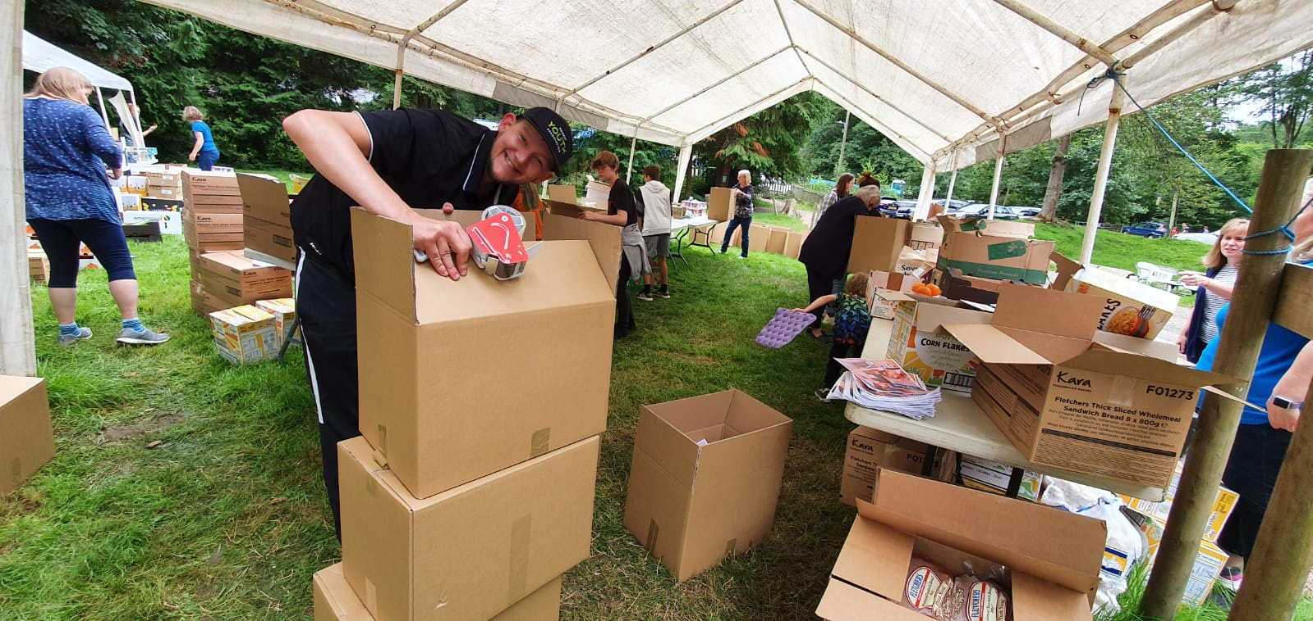

FVAF’S
ESV SCHEME
5 days per year
Skills match
Personal development
Getting to know the community
FOREST VOLUNTARY ACTION FORUM

Slide 6

WHAT’S NEXT...
Your successes
What do you already do that works well?
Local businesses
Your questions and ideas?
Is there an interest to connect more with CVS Organisations?
November 2024
A Know Your Patch Marketplace event to link business and CVS Organisations
FOREST VOLUNTARY ACTION FORUM

Slide 7

THANK YOU!
FOREST VOLUNTARY ACTION FORUM

