Slide 1
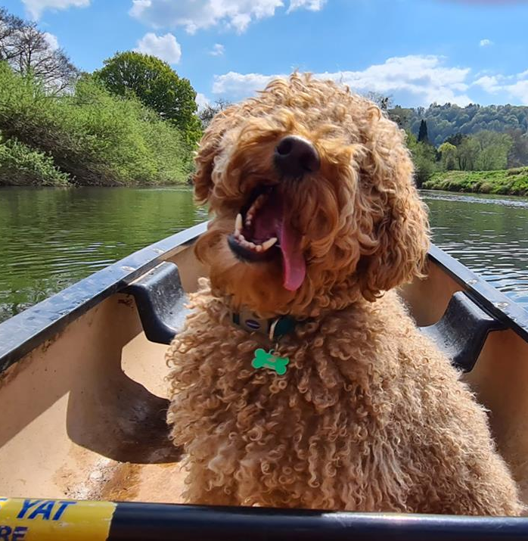
Forest of Dean and Wye Valley Tourism.

Slide 2
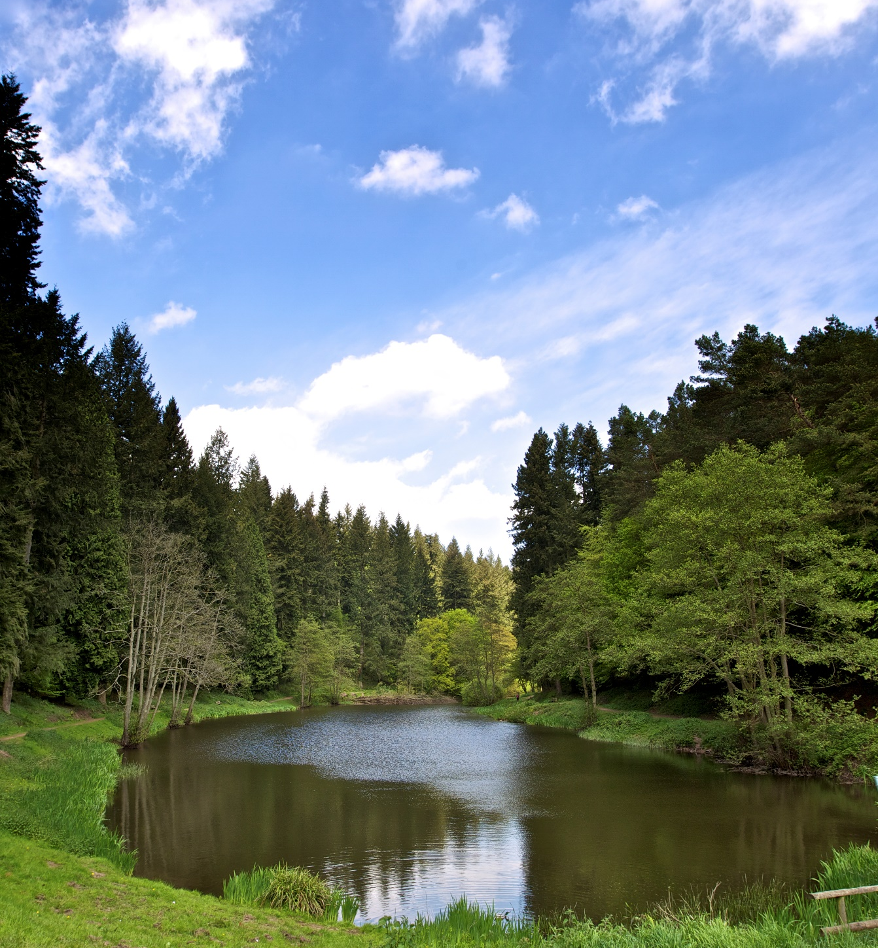
This Session Our Aim What we do What’s Important Supporting FEP Goals How We’re Doing
Notes:
Marketing manager for the Wye Valley and Forest of Dean and keen to drive this incredible destination forward.

Slide 3
Our Aim: To promote the Forest of Dean and Wye Valley as a premier destination, driving sustainable tourism that benefits local businesses and communities.

Slide 4
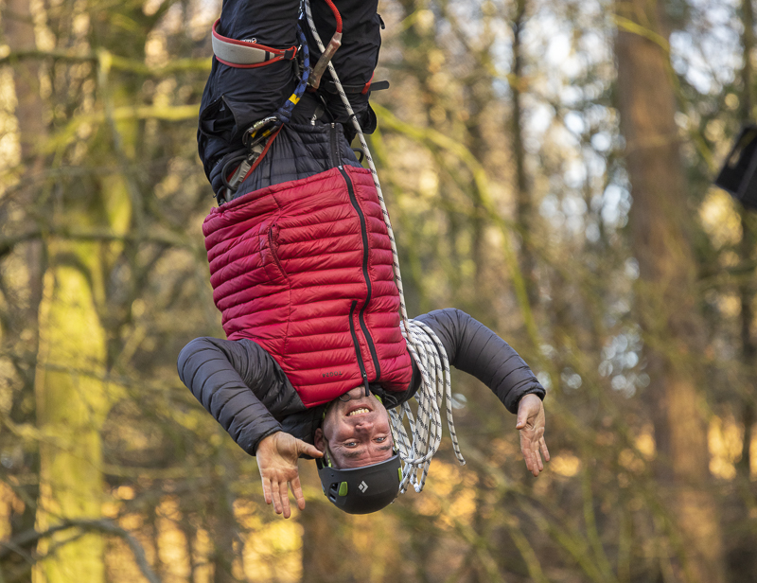
Collaborative Marketing Campaigns Data Sharing Networking & Events Skills Development
What We Do
Notes:
Collaborative Marketing: Suggest joint campaigns or content creation that aligns with both organisations' goals.
4 Social Media Channels, Websites, 2 e-newsletters, Press List, Visit Britain, Blog.
Data Sharing: part of wider groups VLEP & VE – sharing of information, visitor insights and trends that could help inform FEP's economic development strategies.
Networking & Events: Suggest participating in each other's events to cross-promote and strengthen relationships.
Skills Development: Explore ways to support training or workshops that could benefit tourism businesses in the region.

Slide 5
What’s Important? Website traffic/unique visitors Social media engagement Click-through rates to partner listings Visitor spending increases tied to your marketing TAKING ACTION!
Notes:
Website traffic/unique visitors (demonstrates reach)
Social media engagement (shows audience interaction)
Click-through rates to partner listings (proves value)
Any data on visitor spending increases tied to your marketing
Ultimately want to drive action – visiting the area, talking about the area, raising the profile of the area

Slide 6
Supporting FEP Goals? Economic Growth Community Vibrancy Collaborative Working Digital Connectivity
Notes:
Economic Growth: Directly connect this to FEP's aims. Highlight how tourism spending boosts local businesses. Mention any case studies where your marketing led to new jobs or investments in the area – Float in the Forest Community Vibrancy: Showcase how you promote local events and cultural attractions, making the region more appealing to both visitors and residents. Discuss any collaborations Train Tripper – car free travel - with community groups or initiatives? Digital Connectivity: Emphasise our website's role as a central hub for information, making it easier for businesses to connect with customers. Mention any use of technology (e.g., virtual tours, social media campaigns) to enhance the visitor experience and reach wider audiences.

Slide 7
Partner Opportunities Campaigns Collaboration & Joint Marketing Influencers & UGC Community Vibrancy Digital Connectivity “If you want to go fast, go alone; if you want to go far, go together”
Notes:
Campaigns:
Britain’s best kept secret
Dark Skies – co-created content & shared promotional effort – Wye Valley National Landscape
Car Free Travel – GWR & Train Tripper
Collaboration – connecting partenrs to support in wider marketing. Itinerary creation for visitors.
Setting up influencer visits
FEP's sub-group on Infrastructure & Transport might be particularly interested in this initiative.
Community vibrancy – board of directors well linked and community focused for Travel & Tourism – best interests in the area
Digital Connectivity & upskilling – brining up our partners and efforts for the whole area

Slide 8
How we contribute to the Community
Collaboration: Connecting local businesses, community groups, and other stakeholders to promote their events
Small Business Support: boosts demand for local crafts, produce, and services, promoting small businesses and artisans within the community.
Environmental Stewardship: Messages about how to enjoy the forest responsibly
Cultural Preservation: local heritage, traditions, and landmarks, community pride and cultural identity.
Notes:
Raising awareness, connectivity and providing support where its needed most.

Slide 9
How are we doing? Online presence
16.4% increase in users against the same period as last year.
16.7% increase in page views against the same period as last year.
2023 was a record-breaking year for website visitors

Slide 10
Social Media
Facebook reach +29.5% on last year
Page visits
Facebook: +177.8% Instagram: +53.4%
Follower Average across all channels: +82%

Slide 11
Future Priorities
Source funding
Accessibility campaigns coming up, press, influencers and paid social
New website planned for this 2025
Company Collaboration
Notes:
Yeo Valley
Little Greene

Slide 12
Challenges
Small Organisation
Economic Factors
Public Transport
Commitments
Budget

Slide 13
Any questions?
Contact us:
Paul Williamson
Paul.Williamson@visitdeanwye.co.uk

